Slide 1
German charging infrastructure for electric cars: Trends and Potential for Improvement

Slide 2
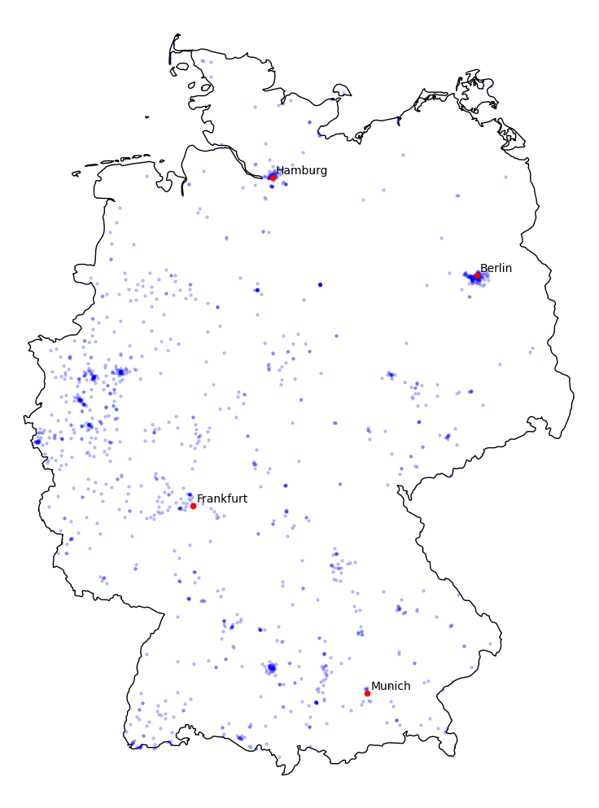
Heatmap 2015

Slide 3
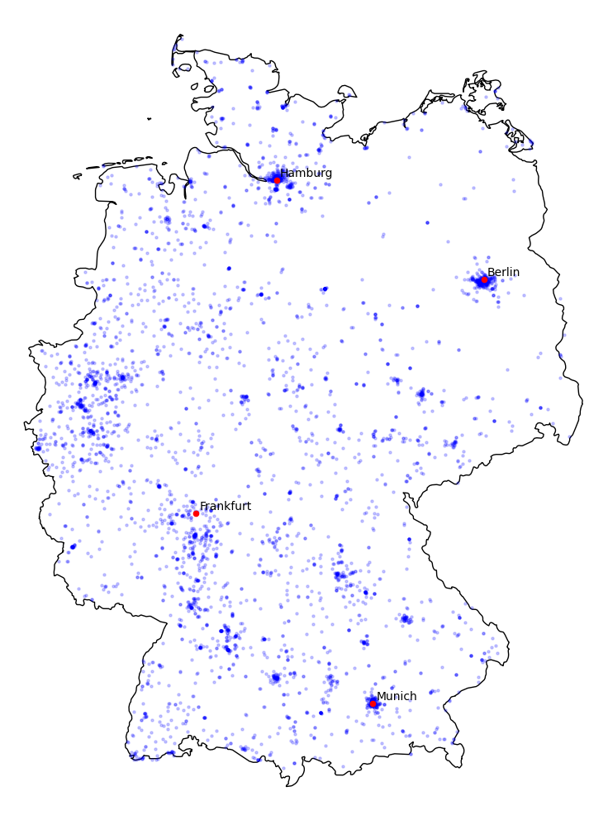
Heatmap 2017

Slide 4
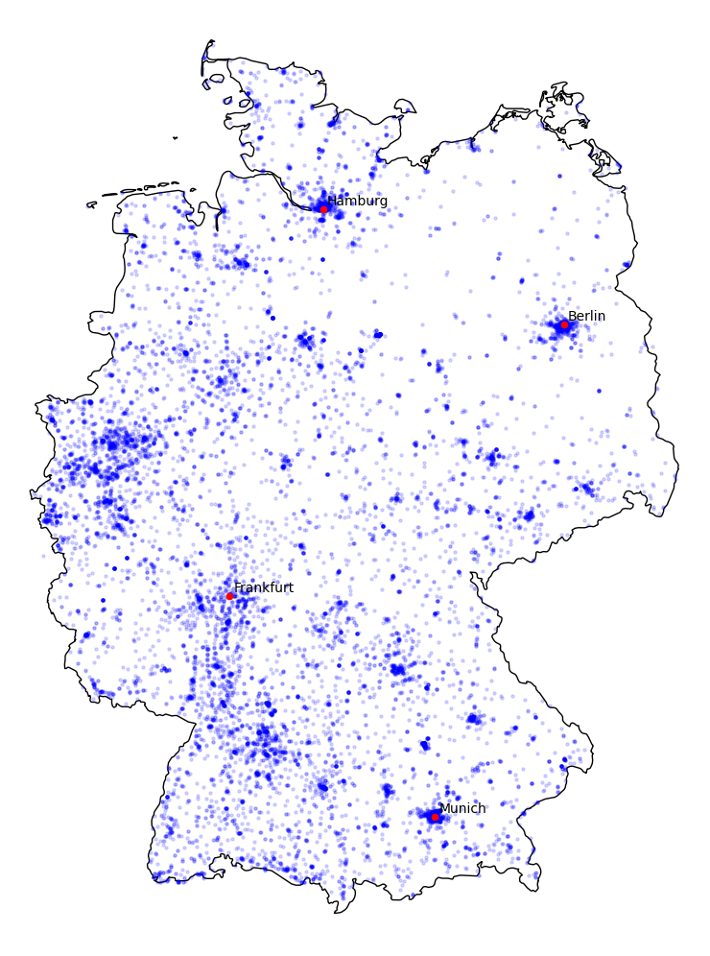
Heatmap 2019

Slide 5
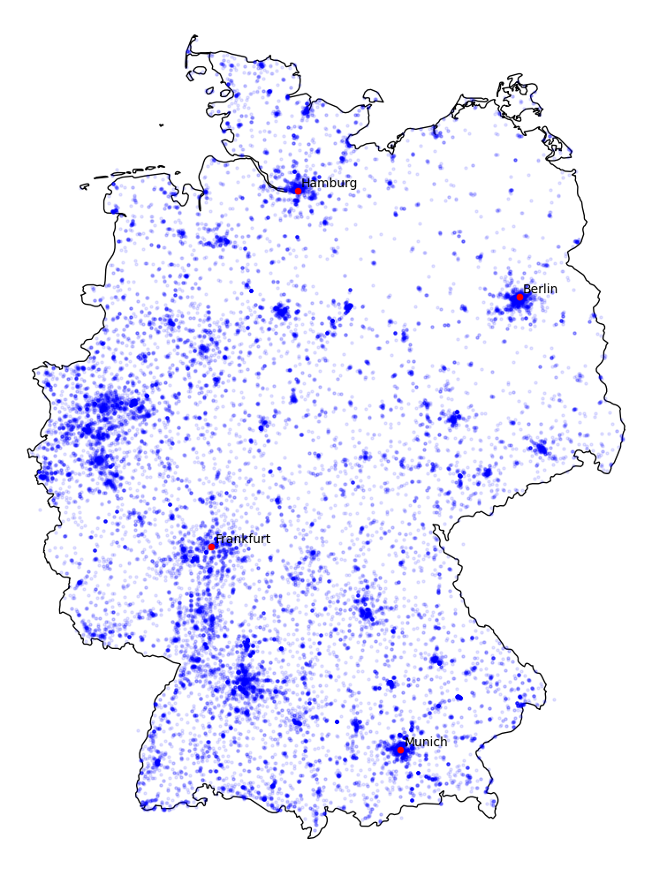
Heatmap 2021

Slide 6
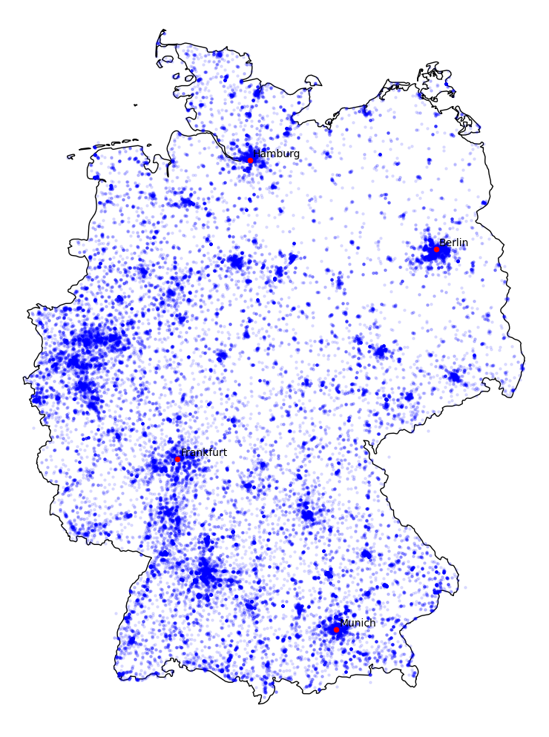
Heatmap 2023

Slide 7
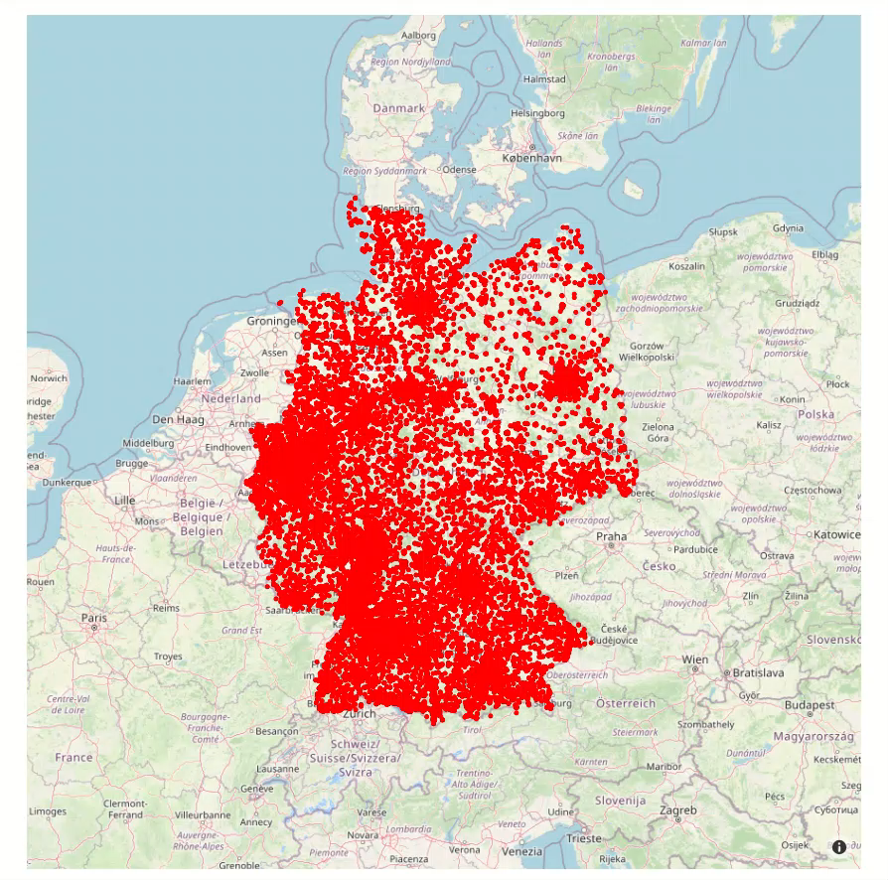
Interactive Heatmap

Slide 8
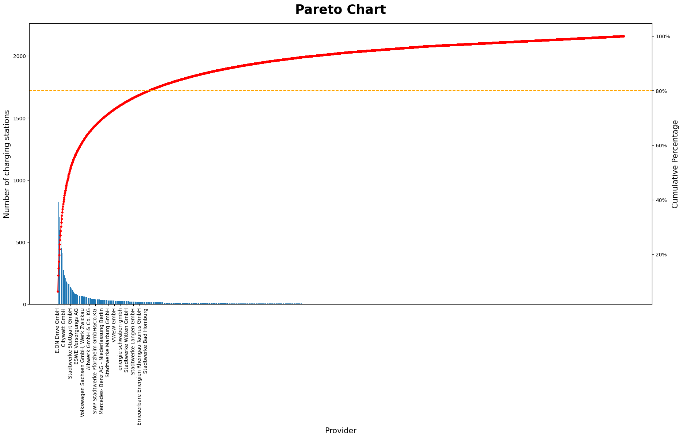
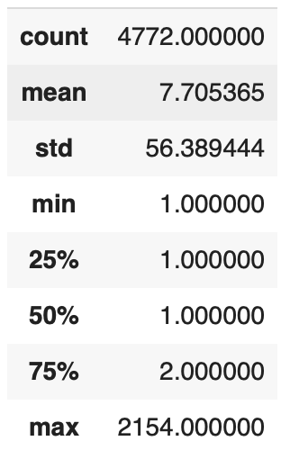
Pareto Chart
20% of the providers (290) make for 80% of the total network

Slide 9
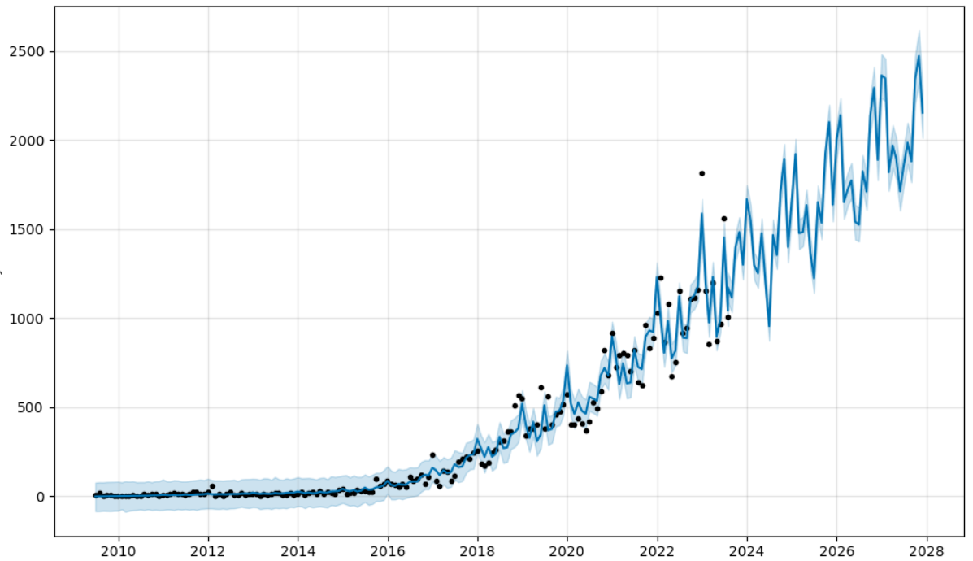
Projection
Charging stations until 2028

Slide 10
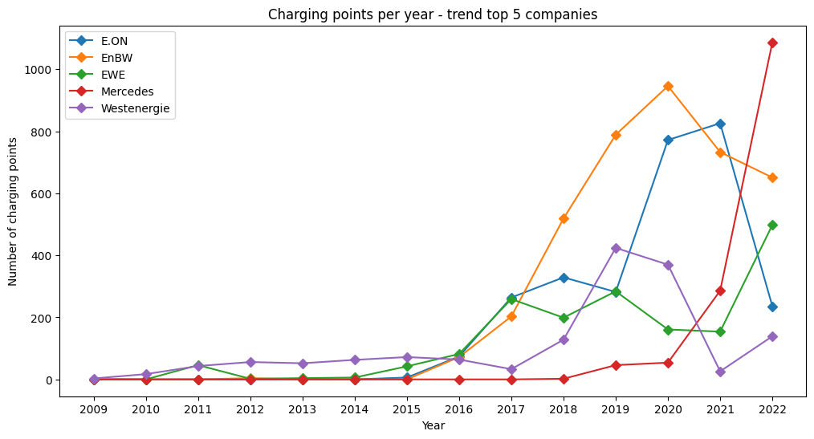
Main provider
Charging points per year – trend top 5 provider

Slide 11
What have we learned?
This project work facilitates practical learning a lot.
When approaching project work, one can opt for defining a question and then seeking suitable data or working with existing datasets and defining a suitable research question.
Learning Python not only enhances technical proficiency but also fosters new perspectives on problem-solving.

Slide 12

Thanks for your attention ☺

